Slide 1
Bird strikes analysis
By Unmilan Baruah

Slide 2
Introduction
Transport and communication are in the crucial domain in the field of analytics. Environmental impacts and safety are, nowadays, two major concerns of the scientific community with respect to transport scenarios and to the ever-growing urban areas. These issues gain more importance due to the increasing amount of vehicles and people. Seeking new solutions is reaching a point where available technologies and artificial intelligence, especially MAS, are being recognized as ways to cope with and tackle these kinds of problems in a distributed and more appropriate way.

Slide 3
Introduction
A bird strike is strictly defined as a collision between a bird and an aircraft which is in flight or on a take-off or landing roll. The term is often expanded to cover other wildlife strikes - with bats or ground animals. Bird Strike is common and can be a significant threat to aircraft safety. For smaller aircraft, significant damage may be caused to the aircraft structure and all aircraft, especially jet-engine ones, are vulnerable to the loss of thrust which can follow the ingestion of birds into engine air intakes. This has resulted in several fatal accidents. Bird strikes may occur during any phase of flight, but are most likely during the take-off, initial climb, approach and landing phases due to the greater numbers of birds in flight at lower levels. This report is a detailed analysis on bird strikes by FAA between 2000-2011.

Slide 4
Purpose
To analyze state-wise analysis of bird strikes.
To analyze the relationship between bird strikes and aircrafts.
To analyze the relationship between bird strikes and wildlife.
To study the impact of weather conditions on bird strikes.
To study yearly distribution of bird strikes and its impact on overall cost for each year.
To understand the distribution of bird strikes based on altitude.
To analyze no. of injuries due to bird strikes.
To check whether bird strikes are influenced by the pilot’s unawareness about possible wildlife/birds in the sky.

Slide 5
Methodology
ETL (Extract, Transform, and Load): Collecting the data, transforming it into something which can be analyzed with accuracy, and loading the processed data for further analysis.
Data Analysis
Observations
Inference

Slide 6
ETL (Extract, Transform, and Load)
The data source is named as “Bird Strikes data.xlsx” and this excel file records related to the bird strikes from 2000 to 2011.
There are total 25558 entries. The Pandas library in Python considers “None” as missing values or NULL. Therefore, while doing EDA (Exploratory Data Analysis), there are a lot of NULLs for the columns: Effect: Impact to flight, and Conditions: Precipitation. So, we change the “None” for these two columns into other strings. However, no such situation is faced while doing the data visualization analysis in Tableau.
However, few of the columns have only 129 values. So, we remove those records. Also, the Remarks column has a lot of missing values and because of its irrelevance with bird strikes, we ignore this column.

Slide 7
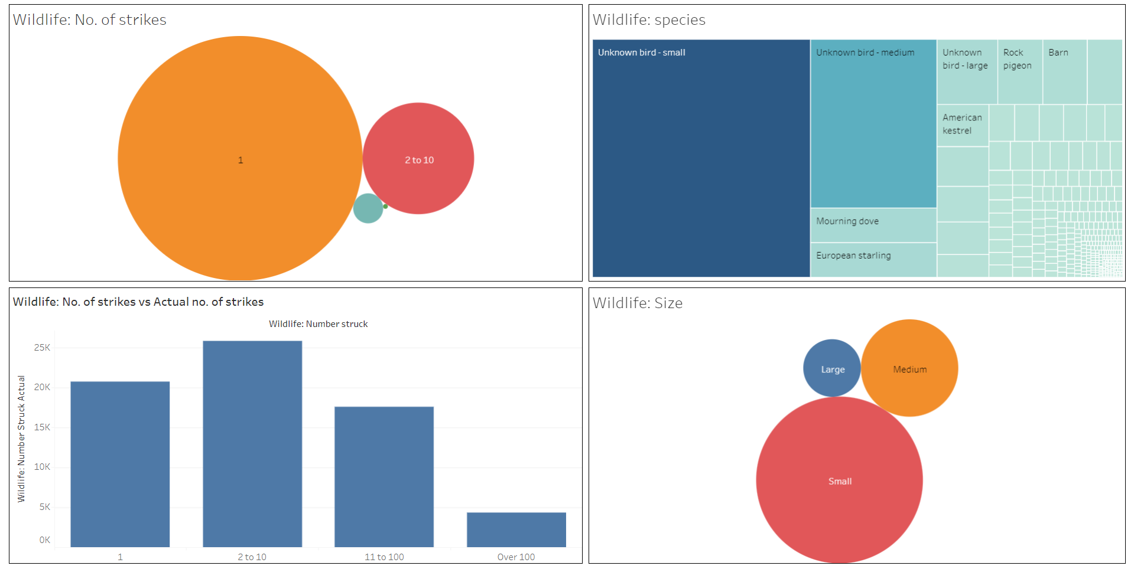
Data Analysis

Slide 8
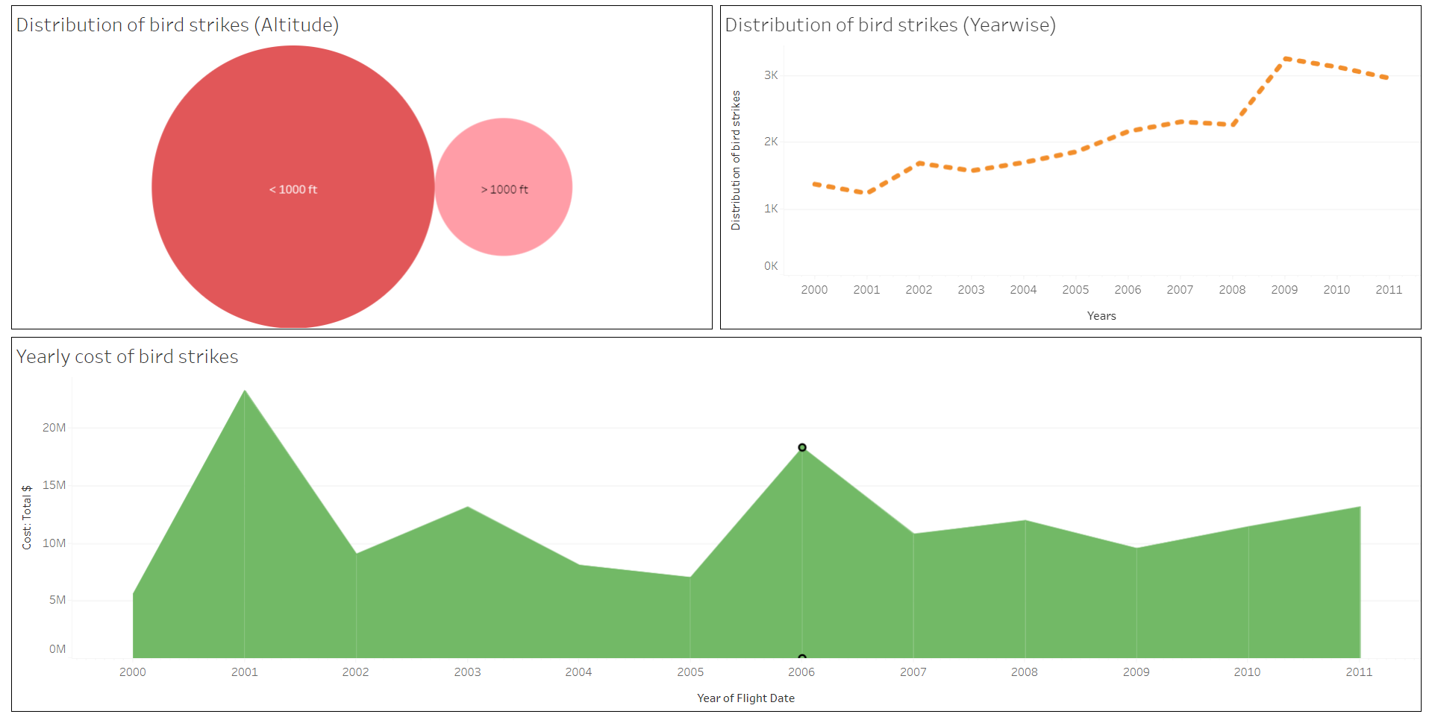
Data Analysis

Slide 9
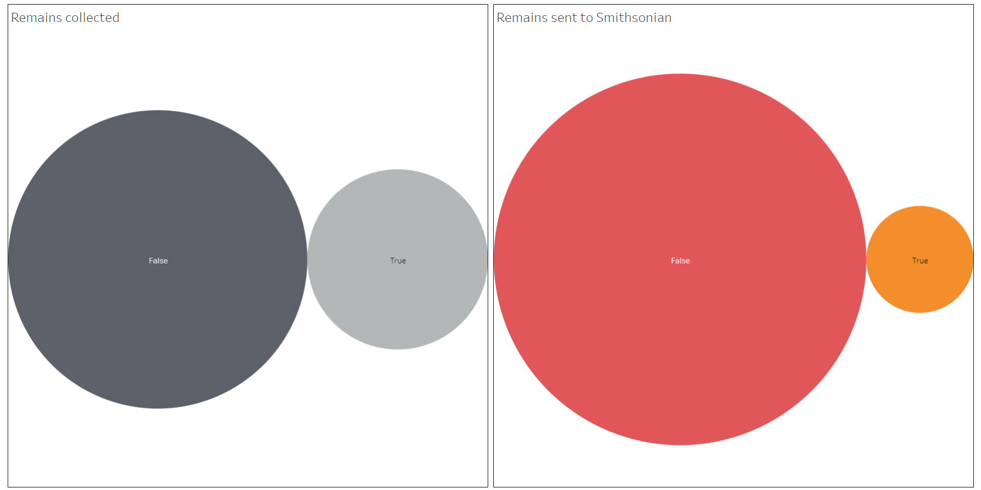
Data Analysis

Slide 10
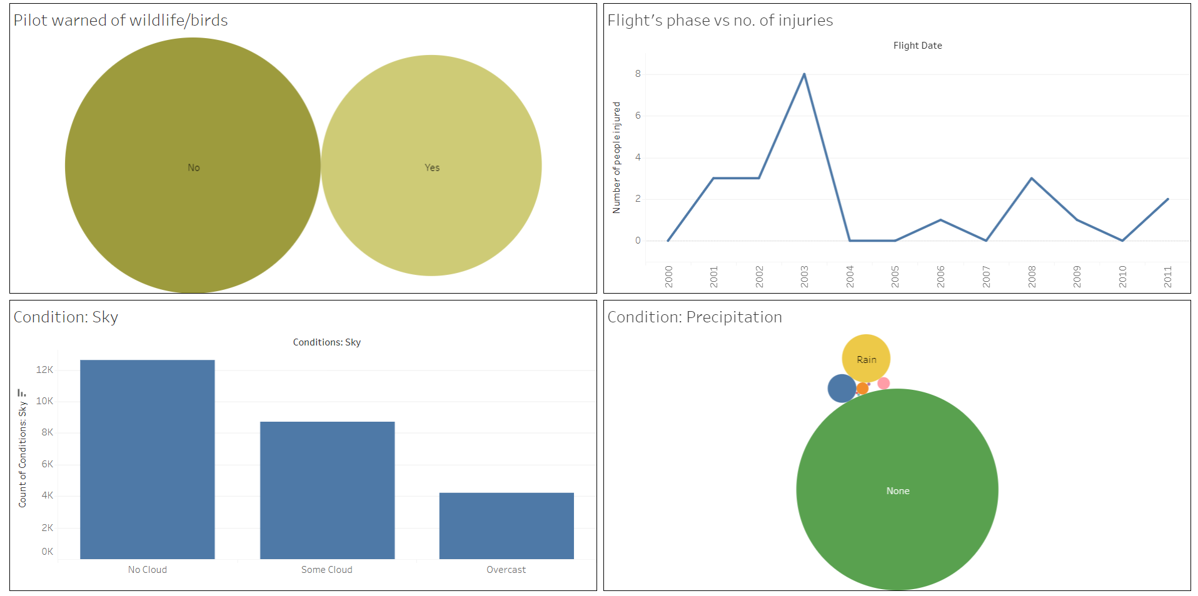
Data Analysis

Slide 11
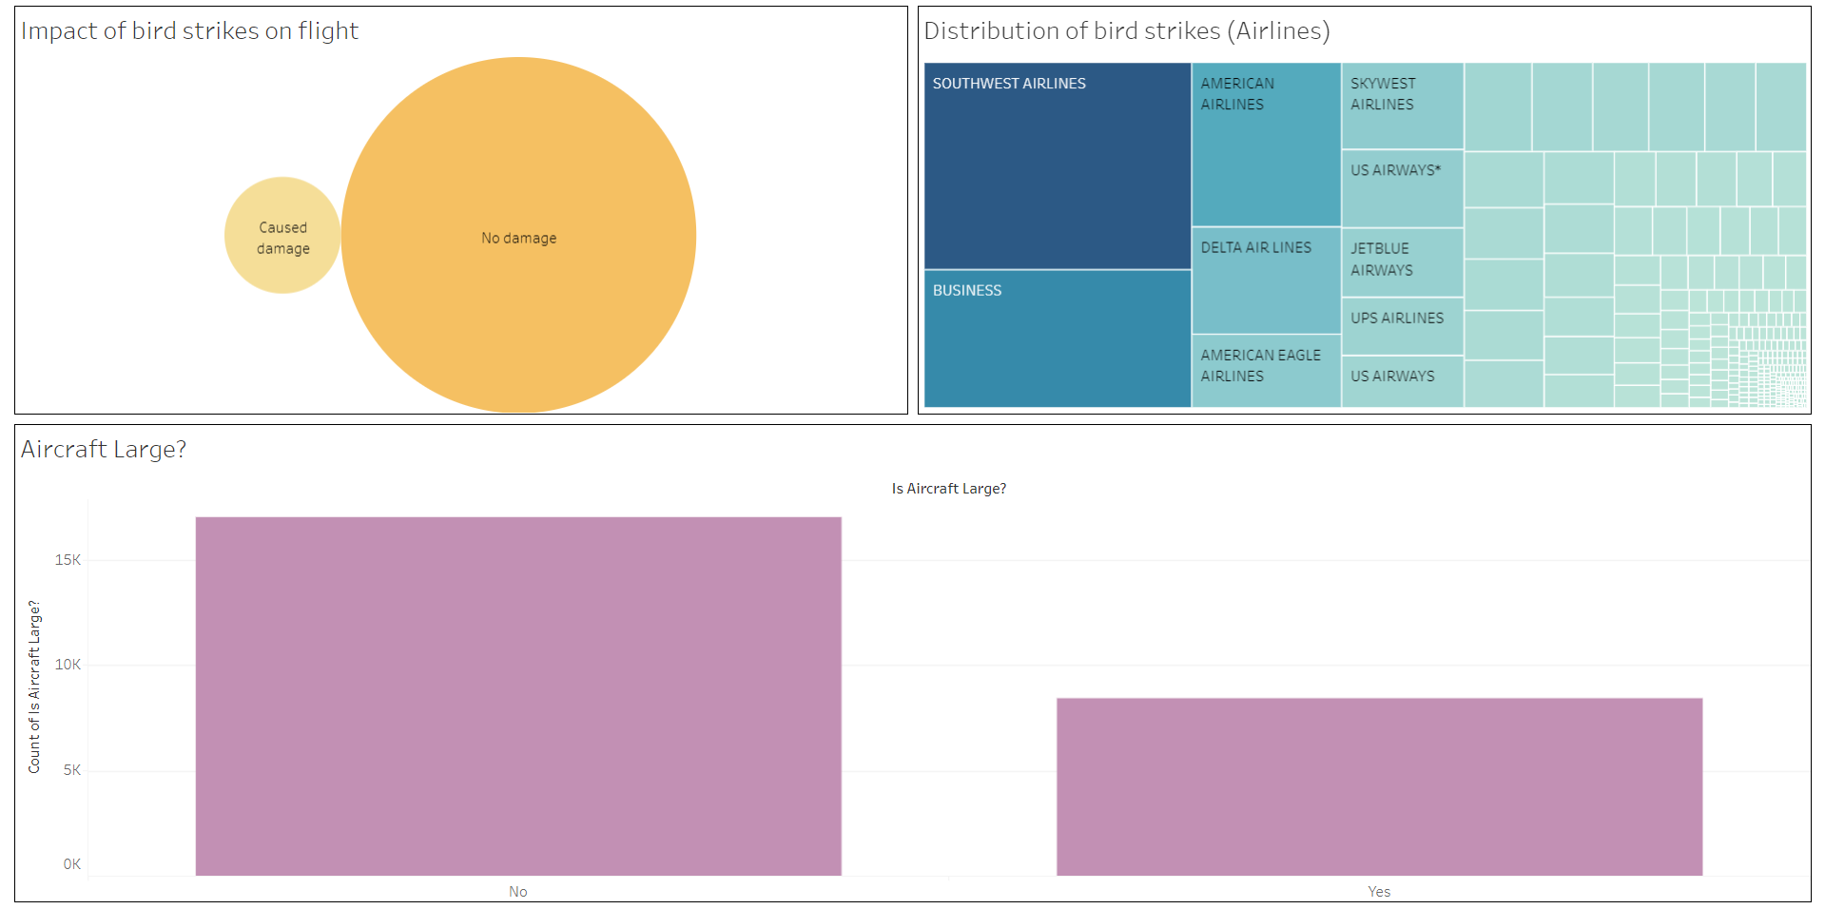
Data Analysis

Slide 12
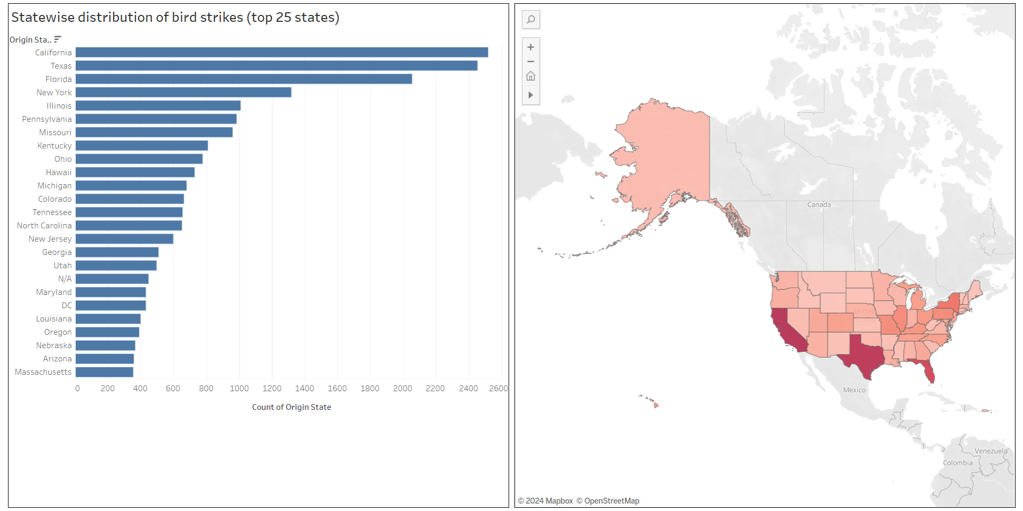
Data Analysis

Slide 13
Observations
With 2520 bird strikes, it is observed that bird strikes are the highest in the state of California, followed by Texas, and then by Florida.
The highest no. of bird strikes is observed for the SOUTHWEST AIRLINES, followed by BUSINESS, and then by AMERICAN AIRLINES.
There was very less impact of bird strikes on aircrafts. However, most bird strikes are caused by smaller aircrafts.
No significant influence on bird strikes was observed due to weather conditions or the pilot’s unawareness about possible wildlife/birds in the sky. However, no. of injuries due to bird strikes was the highest in the year 2003.

Slide 14
Observations
Yearly cost due to bird strikes is the highest in the year 2001, and the no. of bird strikes was the highest in the year 2006.
Most bird strikes are observed below 1000 ft.
Most of the bird species injured were of smaller size.
Most of the bird strikes were actually below 100.

Slide 15
Inference
The state of California, Texas, and Florida has extremely high no. of bird strikes overall with above 2000 from each of these three states. So, necessary rules and regulations related for aircrafts are necessary in these states to reduce the high no. of bird strikes in these states.
Strict monitoring of SOUTHWEST AIRLINES, BUSINESS, and AMERICAN AIRLINES is necessary because more than 2000 bird strikes for each of these airlines.
Pilot’s unawareness as well as weather conditions are observed to have less influence on no. of bird strikes. However, smaller aircrafts are necessary to be monitored more than larger aircrafts as more bird strikes are recorded from smaller aircrafts. Also, caution needs to be taken for smaller as well as medium-sized wildlife species.

Slide 16
Thank You

